Slide 1
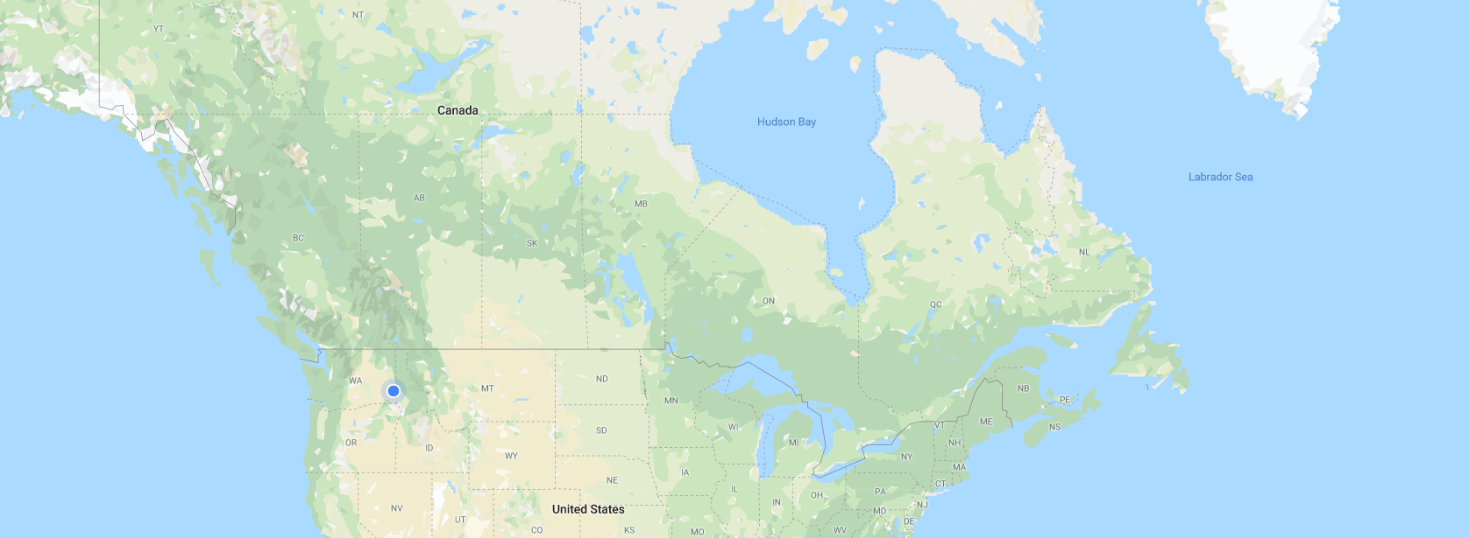
TRAM VISUALIZATION
Mapping GPS Coordinates and changing transmission lines’ color based on the line rating.
Normal → Green color
Not Normal → Red color
Nodes will be colored based on the voltage.
VOLTAGE TABLE
LINE RATING LABELS
Colors will change based on the line rating.
More than 90% → Orange color
Over 100% → Red color
The values will be sorted in decreasing order of the line rating.

